Slide 1

LOB Data Management
https://github.com/db-berater/handling-lob-data

Slide 2
Links for this Session/Workshop
Scripts and Slide Decks https://t1p.de/LOBManagement
ERP Demo Database (17.00 GB) https://db-berater.de/downloads/ERP_Demo_2012.bak
SQLQueryStress https://github.com/ErikEJ/SqlQueryStress
Windows Admin Center https://go.microsoft.com/fwlink/?linkid=2220149

Slide 3




Uwe Ricken db Berater GmbH
I am working with IT-systems since early 1990's and with the main focus on Microsoft SQL Server since version 6.0. I started with development of database applications in 1998 with a professional CRM-System based on Microsoft products (Microsoft Office and Microsoft SQL Server).
Since 2008 I'm focused exclusively on Microsoft SQL Server and since 2008 I'm working in 3rd level support teams for banks, insurances and global industries.
Since May 2013 I'm a Microsoft Certified Master: SQL Server 2008 which was an amazing way into the depth of Microsoft SQL Server.
In July 2013 I have been awarded with the MVP Award for Microsoft SQL Server.
www: http://www.db-berater.de
email: uwe.ricken@db-berater.de
blog: http://www.sqlmaster.de
BlueSky: @sqlbambi

Slide 4
Agenda
What is the LOB data type?
How are LOB data organized in SQL-Server
ROW OVERFLOW DATA
LOB DATA
Problems with storage of LOB Data
In-Row-Data
Out-Of-Row-Data
Expensive Updates
Selection of data

Slide 5
How are Data stored in SQL-Server?
A generic overview

Slide 6
Data Storage Internals
Every Heap / Clustered Index / Nonclustered Index is a separate storage object.
All have the same internal structure!
HEAP / (non)clustered Index
Partition 1
Partition 2
Partition 3
Partition n
In Row Data
data stored directly within a table's data row (max: 8,060 Bytes)
Out Of Row Data
data stored partially outside of the data row if the row size exceeds
LOB Data
Large text elements / documents / pictures / …
Notes:
000 - Basics about relations indexes partitions allocation units pages etc.sql

Slide 7
Row Overflow Data

Slide 8
ROW OVERFLOW DATA
SQL Server stores variable-length columns on row-overflow pages only under certain conditions.
The determining factor is the row length itself.
How full the regular page is, into which SQL Server is trying to insert the new row, doesn’t matter.
SQL Server constructs the row as usual and stores some of its columns on overflow pages only if the row itself needs more than 8,060 bytes.

Slide 9
Row Overflow Data – Scenario 01
Data Page #1024
/* The text size is 5K */
UPDATE demo.customers
SET c_comment = 'Long Text'
WHERE c_custkey = 1;
Data Page #3024
c_custkey | c_name | c_acctbal | c_comment
1 | Customer#01 | 5.302,38 | NULL
2 | Customer#02 | 6.059,20 | NULL
3 | Customer#03 | 7.510,04 | NULL
… | … | … | …
… | … | … | …
… | … | … | …
… | … | … | …
… | … | … | …
… | … | … | …
… | … | … | …
… | … | … | …
… | … | … | …
… | … | … | …
78 | Customer#78 | 1.487,01 | NULL
c_custkey | c_name | c_acctbal | c_comment
11 | Customer#11 | 8.987,76 | NULL
… | … | … | …
… | … | … | …
… | … | … | …
… | … | … | …
… | … | … | …
… | … | … | …
78 | Customer#78 | 1.487,01 | NULL
c_custkey | c_name | c_acctbal | c_comment
1 | Customer#01 | 5.302,38 | Long Text
2 | Customer#02 | 6.059,20 | NULL
3 | Customer#03 | 7.510,04 | NULL
… | … | … | …
… | … | … | …
10 | Customer#10 | 3.353,31 | NULL
PAGE SPLIT

Slide 10
Row Overflow Data – Scenario 02
Data Page #1024
/* The text size is 9K */
UPDATE demo.customers
SET c_comment = 'Long Text'
WHERE c_custkey = 1;
Mixed Data Page #3024
c_custkey | c_name | c_acctbal | c_comment
1 | Customer#01 | 5.302,38 | NULL
2 | Customer#02 | 6.059,20 | NULL
3 | Customer#03 | 7.510,04 | NULL
… | … | … | …
… | … | … | …
… | … | … | …
… | … | … | …
… | … | … | …
… | … | … | …
… | … | … | …
… | … | … | …
… | … | … | …
… | … | … | …
78 | Customer#78 | 1.487,01 | NULL
c_custkey | c_name | c_acctbal | c_comment
1 | Customer#01 | 5.302,38 | Ref: #3024
2 | Customer#02 | 6.059,20 | NULL
3 | Customer#03 | 7.510,04 | NULL
… | … | … | …
… | … | … | …
… | … | … | …
… | … | … | …
… | … | … | …
… | … | … | …
… | … | … | …
… | … | … | …
… | … | … | …
… | … | … | …
78 | Customer#78 | 1.487,01 | NULL
Content
On a brisk autumn afternoon, the small town of Eldoria was alive with the vibrant colors of fall. The leaves had turned into a mosaic of reds, oranges, and yellows, painting the landscape with a warm, golden hue. The air was crisp, and the scent of pine and earth lingered, reminding everyone that the colder days were on their way. Despite the chill, the townspeople went about their day with a sense of purpose and cheer. Eldoria was a quaint town, nestled in the hills, far from the hustle and bustle of the big cities. It was a place where everyone knew everyone, and the community was tightly knit. The town square, with its cobblestone paths and charming shops, was the heart of Eldoria. It was a place where stories were shared, laughter echoed, and memories were made. On this particular day, the town square was buzzing with excitement. It was the day of the annual Harvest Festival, a celebration that brought the entire community together. The festival was a tradition that dated back generations, honoring the hard work of the farmers and the bountiful harvest they reaped. Stalls lined the square, offering a variety of homemade goods, from fresh produce to…

Slide 11
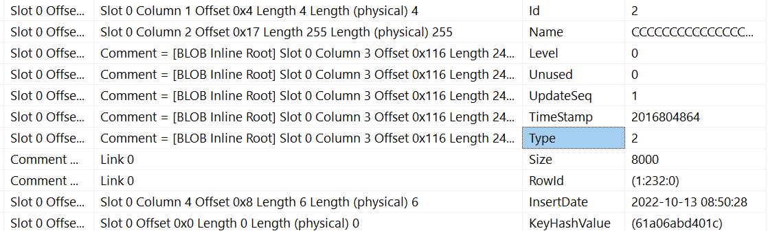
ROW OVERFLOW DATA
SQL-Server stores data on regular 8 KB data pages
If a record size exceeds the maximum row size it must be stored on other physical pages with additional 24 Bytes for every record!

Slide 12
ROW OVERFLOW DATA
Attribute | Description | Notice
Level | Level in the B-Tree | Always 0 for overflow data
Unused | -- | --
UpdateSeq | Sequence: a value used by optimistic concurrency control for cursors that increases every time a LOB or overflow column is updated
TimeStamp | a random value used by DBCC CHECKTABLE that remains unchanged during the lifetime of each LOB or overflow column
Type | Type of special field | 1 = LOB 2 = overflow

Slide 14
ROW OVERFLOW DATA
UPDATE demo.customers
SET Comment = REPLICATE('A', 4000)
WHERE c_custkey = 2;
Data Page
Data Page
Data Page
Record #1
Record #1
Record #2
Record #2
AAAAAAAAAAAAAAAAAAAAAAAAAAAAAAAAAAAAAAAAAAAAAAAAAAAAAAAAAAAAAAAAAAAAAAAAAAAA…
Record #3
Record #3
Record #4
Record #4
Record …
Record …

Slide 15
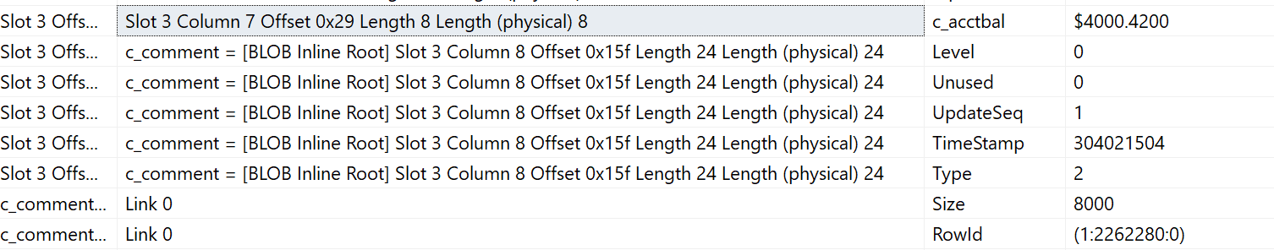
ROW OVERFLOW DATA
UPDATE demo.customers
SET Name = REPLICATE('C', 256),
Comment = REPLICATE('B', 8000)
WHERE c_custkey = 4;
Data Page
Data Page
1:2262280
Record #1
Create a Pointer (24 Bytes)
Record #4
BBBBBBBBBBBBBBBBBBBBBBBBBBBBBBBBBBBBBBBBBBBBBBBBBBBBBBBBBBBBBBBBBBBBBBBBBBBBBBBBBBBBBBBBBBBBBBBBBBBBBBBB…
Record #2
Record #3
Record #4
Record #5

Slide 16
LOB Data

Slide 17
What is a LOB data type?
LOB = Large Objects
ROWSTORE data are stored on 8.192 Bytes data pages
LOB Data allow storage of values >= NULL and < 2.048 MB
LOB Data will be stored on 8.192 Bytes data pages and allocate 8,040 bytes
LOB Data have ALWAYS variable width character!
Types of LOB data in SQL Server
(N)TEXT <= SQL Server 2000
(N)VARCHAR(max)
IMAGE <= SQL Server 2000
FILESTREAM
(VAR)BINARY(max)

Slide 18
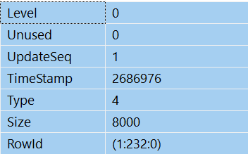
Organisation of (B)LOB Data
Data Page
UPDATE demo.customers
SET c_ompanylogo = REPLICATE(0x00, 16000)
WHERE c_custkey = 1;
Record #1 + Pointer (24 Bytes!)
TEXT TREE PAGE (1:232:0)
Pointer #1
Pointer #2
TEXT MIXED PAGE
TEXT MIXEDPAGE
TEXT MIXEDPAGE
Pointer #n

Slide 19
Special features to consider
LOB data should be stored on a separate filegroup
Force the storage of LOB data as OUT OF ROW data by using sp_tableoption
If LOB data are stored OUT OF ROW by default the pointer has a size of 16 Bytes instead of 24 Bytes!
If a row must store LOB data, it will use a 16/24 Bytes Pointer at the end of the row for every LOB reference.
If the LOB will not be inserted with the row an update of LOB data can cause fragmentation of the clustered index when it adds additional 16/24 Bytes for the reference.

Slide 20
Negative Impact of Default In-Row LOBs
Slow Queries
Low Row Counts per Page.
Non-LOB queries still include LOB data on every page.
Effects on Page Density
Wasted Memory and Disk
Disk to Memory Loads matter even with SSDs/Flash Disks
Extra Indexes required for speed
Faster because they don’t contain the LOB data.
Duplication of Data
More indexes to maintain.
expensive Updates
Page Splits
Fragmentation
Index Maintenance
Log File Use

Slide 22

https://t1p.de/LOBManagement

